Slide 1

SALES PERFORMANCE REPORT
-Analyzing Revenue Trends, Product Performance & Regional Sales

Slide 2

Project Overview
Project: Sales Performance Dashboard
Domain: Data Analytics
Objective: To analyze sales data and monitor overall business performance.
Dataset: Sales transaction data from January to June 2026.
Tools Used: Microsoft Excel and Power BI.

Slide 3

Project Objectives & Business Use Case
Objectives
Analyze overall sales performance using historical sales data.
Track key performance indicators (KPIs).
Identify monthly revenue trends.
Compare sales performance across regions and products.
Present insights through an interactive Power BI dashboard.
Business Use Case
The dashboard helps sales managers and business stakeholders monitor sales performance, identify high-performing products and regions, and make informed business decisions.

Slide 4


Dataset & Tools Used
Tools & Technologies
Dataset Overview
Source: Provided sales transaction dataset.
Time Period: January – June 2026.
Total Records: 240 sales transactions.
Total Columns: 8.
Data Fields: Order ID, Date, Product, Quantity, Unit Price, Total, Region and Salesperson.
Tools | Purpose
Microsoft Excel | Data cleaning, validation and analysis
Power BI | Dashboard creation and visualization

Slide 5
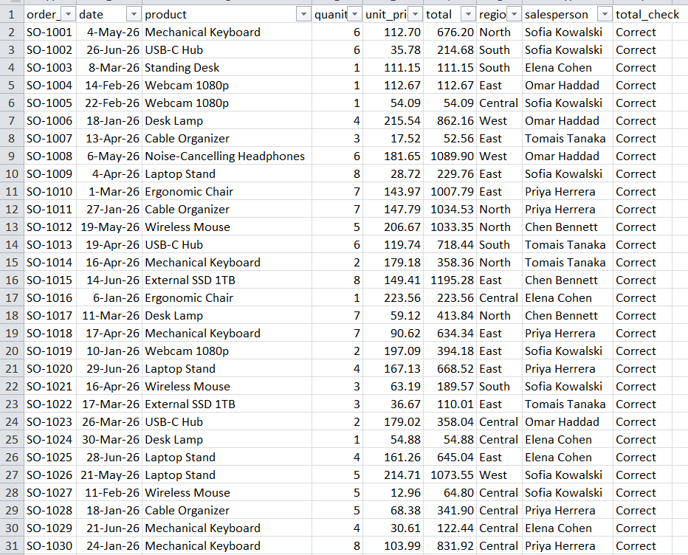
Data Cleaning & Validation
Data Validation Results
Total Records Checked: 240
Missing Values: 0
Duplicate Records: 0
Incorrect Sales Calculations: 0
Validation Status: All records passed the total calculation check.
Data Cleaning
Imported the original sales dataset into Microsoft Excel.
Checked for missing and duplicate records.
Verified date and numerical data formats.
Checked quantity and unit price values for invalid entries.
Created a validation formula to verify sales totals.

Slide 6
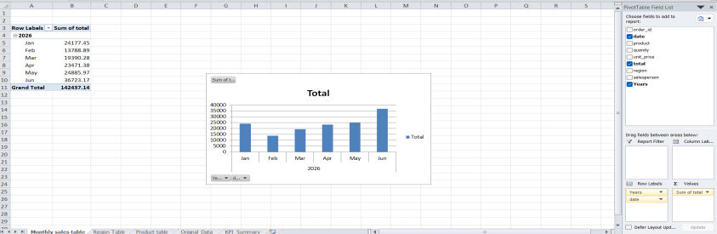
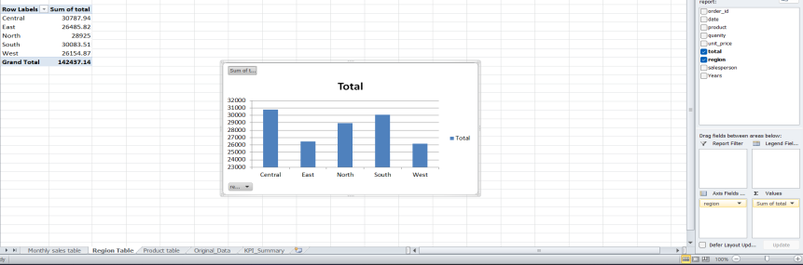
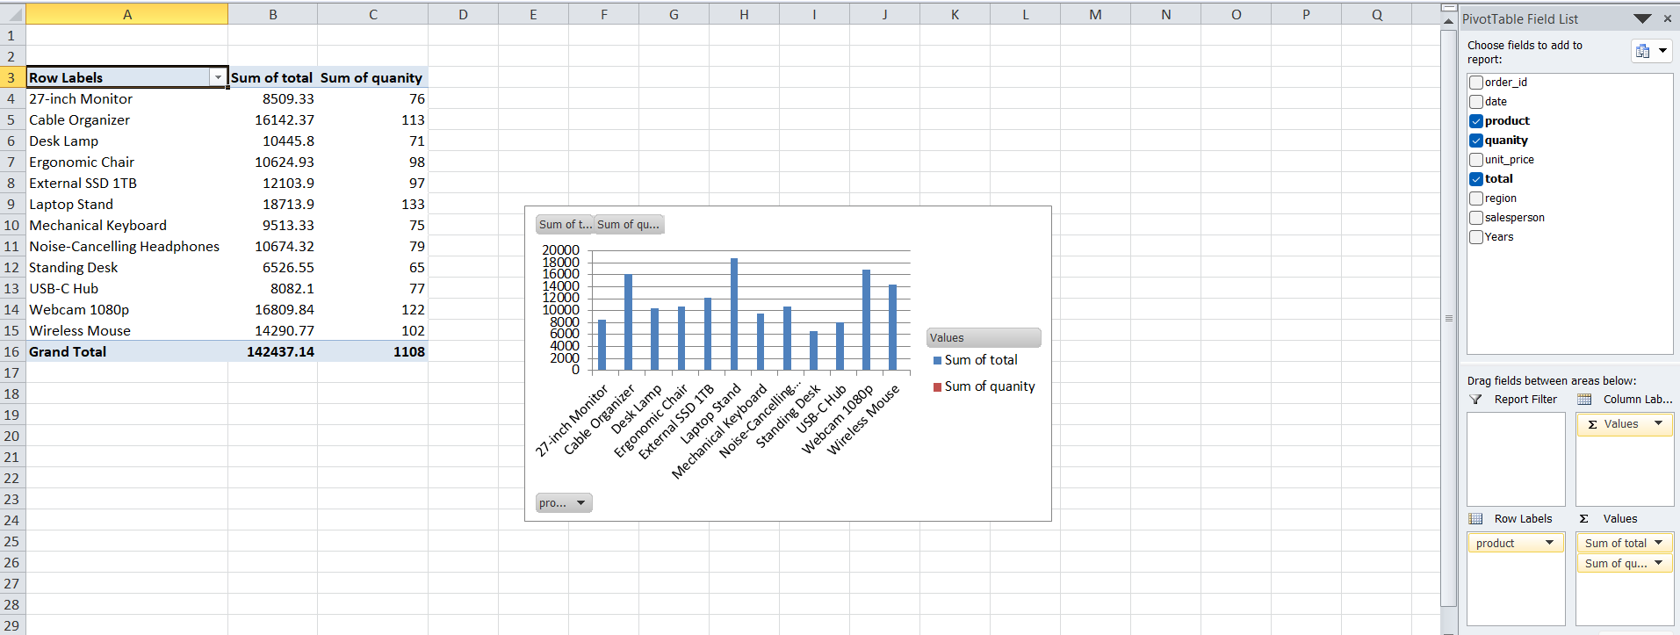
Excel Pivot Analysis
Region-wise Sales Analysis
Compared revenue performance across five regions.
Identified regional differences in sales contribution.
Monthly Revenue Analysis
Analyzed monthly sales revenue using PivotTables.
Identified revenue trends across the reporting period.
Product-wise Sales Analysis
-Evaluated revenue generated by different products.
-Compared product-wise units sold.

Slide 7
KPI Summary
Total Revenue: ₹142,437.10
Total Orders: 240
Units Sold: 1,108
Average Order Value: ₹593.49

Slide 8
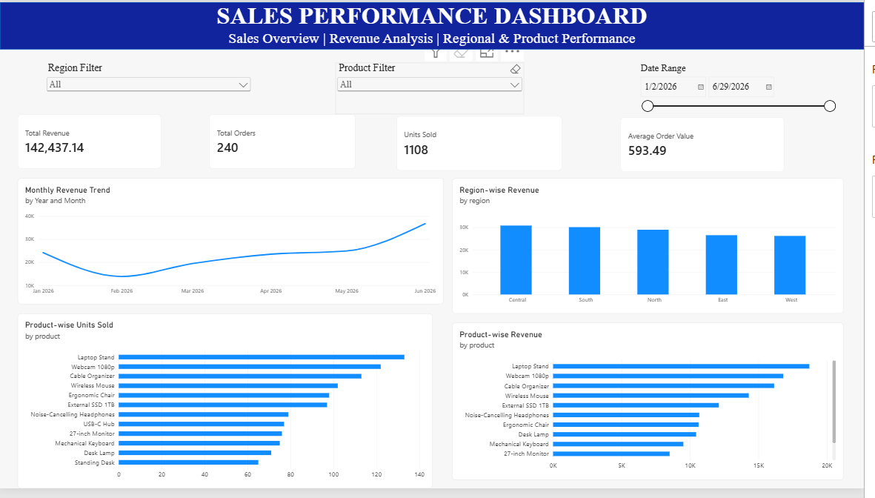
Power BI Dashboard
Dashboard Features
Interactive KPI cards displaying Revenue, Orders, Units Sold and Average Order Value.
Monthly Revenue Trend to monitor sales performance over time.
Region-wise Revenue comparison.
Product-wise Revenue and Units Sold analysis.
Interactive slicers for Region, Product and Date.

Slide 9
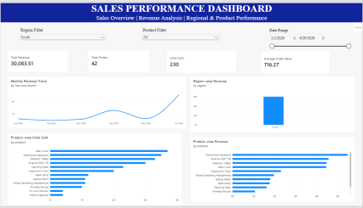
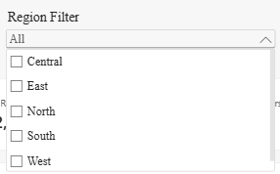
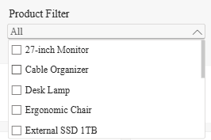
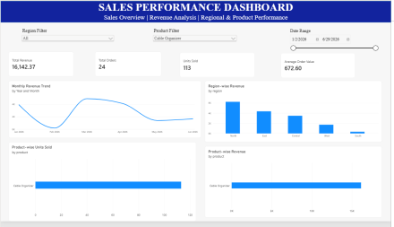
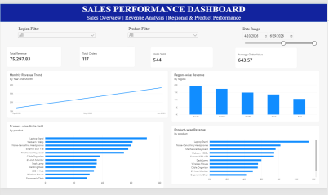

Interactive Filters & Slicers
Region Filter
Allows users to view sales performance across individual regions.
Helps compare regional revenue contributions.
Product Filter
Enables analysis of selected products.
Helps evaluate product-wise revenue and units sold.
Date Range Filter
-Allows users to select a specific reporting period.
-Helps examine sales trends over time.

Slide 10

Future Improvements & Conclusion
Future Improvements
Integrate SQL for efficient data querying and management.
Include profit and cost data for profitability analysis.
Add customer and sales channel data for deeper insights.
Extend the dashboard with regularly updated sales data.
Conclusion
The Sales Performance Dashboard successfully transforms raw sales data into meaningful business insights using Excel and Power BI. It provides an interactive way to monitor KPIs, analyze trends, and compare product and regional performance to support data-driven decisions.

Slide 11
Thank You

